Slide 1
Logistic Regression Model to predict if the employee is going to leave the company or not and determine the factors driving it
Done by:
Sreeharsh Nair
IIT MADRAS
Ph:8281400538
harshnair34@gmail.com

Slide 2
Case study overview
1. Problem definition
A company ABC, even though they have many employees, their employees are leaving the company after every 3-4 months and they have to hire new talent from the market. Training them and guiding them becomes extremely difficult. So the company wants to understand why people are leaving their company on a frequent basis. They want to know:
- Which variables are significant in predicting the decision of leaving the company
- How well those variables describe the probability of the person leaving the company
2. Objectives
To build a model which gives the decision of leaving with the available independent variables. To understand how exactly the decision varies with the independent variables. Further, to understand the shortcomings in their current system with the developed model.

Slide 3
Methodology – CRISP Modelling
Identify the problem
Data collection
& understanding
Data manipulation ( to find missing data)
Feature creation for model (data preparation)
Model building
Model evaluation and validation

Slide 4
Data understanding and exploration
The data set contains 14999 entries and 10 columns.
The names of those columns are:
[ Number of projects, work_accident, left, promotion last 5 years, department, salary, time_spend_company, average_monthly_hours, satisfaction_level, last_evaluation ]
Target variable is ‘left’.
There were no missing values in the data that we prepared for our analysis.
Technical: we have assumed that ‘technical’, ‘IT’ and ‘support’ are the same categories. Hence, we have grouped them together.

Slide 5
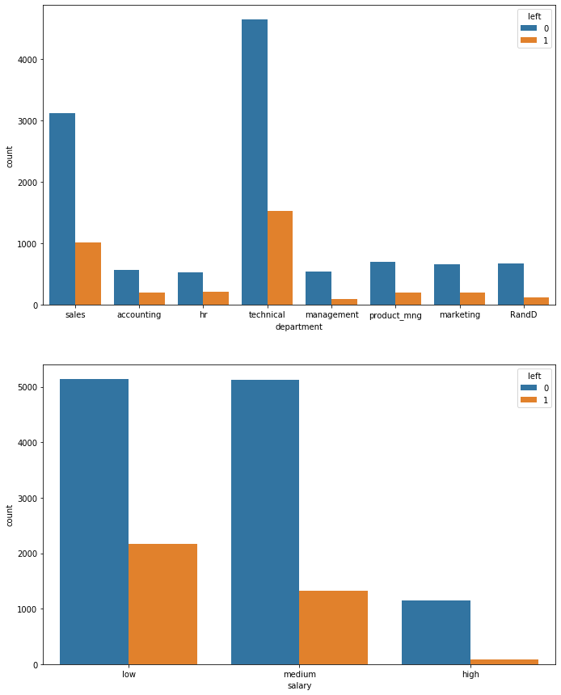
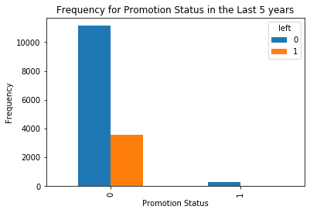
Out of the available features the following were chosen to help us in predicting the problem:
Promotion last 5 years – not getting promotions and hence they are leaving the company.
Salary – low salary range employee are leaving.
Department – technical department has the highest % of leaving.

Slide 6
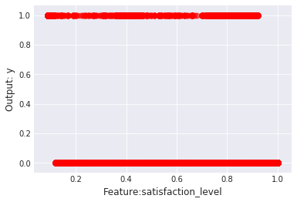
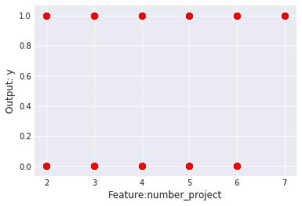
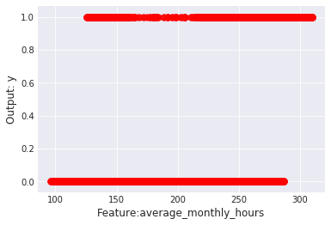
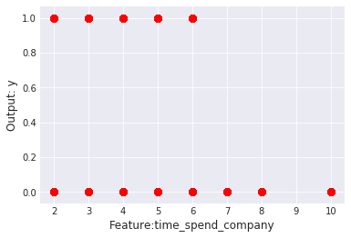
In order to understand correlation between output(left) and other variables plots were made.
Satisfaction_level, number_project, average_monthly_hours, time_spend_company were plotted against left.
As expected, the graph has only max and min value i.e. 0 and 1.

Slide 7
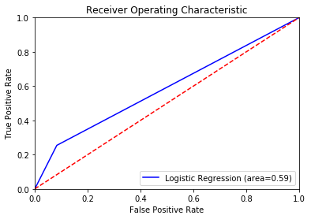
Model fitting and prediction
Logistic regression:
Misclassification rate =23.69%
Area under ROC curve =0.59
Predicted | Actual
0 | 1
0 | 0
0 | 0
0 | 0
0 | 0
 | Predicted NO | Predicted YES
Actual NO | 2641 | 240
Actual YES | 648 | 221

Slide 8
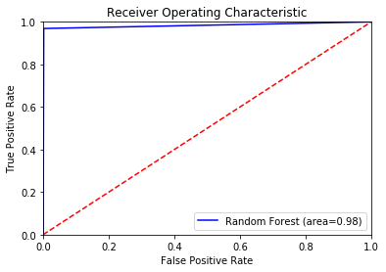
2. Random Forest:
Area under ROC curve =0.98
Predicted | Actual
1 | 1
0 | 0
0 | 0
0 | 0
0 | 0

Slide 9
Conclusion and insights
Was able to develop a logistic regressor model to predict why employees leave the company.
Technical training could be done more efficiently, as most people leaving are from technical background.
Most employees in the low or medium salary category leaves the company. Hence salary is important.
People also leave the company if they are not offered with promotion for five years.
Satisfaction level of employees is very important for a company. Employee with high satisfaction level have less chance of leaving the company.

Slide 10
THANK YOU!

